Slide 1
Unit-6
Direction Sense
Blood Relation

Slide 2
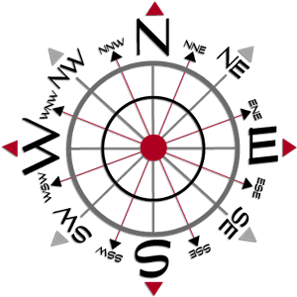
Direction Sense

Slide 3

Direction sense is one of the prime topics in logical reasoning.
Questions from this topic generally involve an individual travelling certain distances in certain directions.
The best way to solve these problems is to represent the traces of the path traversed by the person, as found in the information provided by the question.

Slide 4
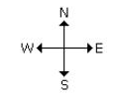

There are four main directions –
North, South, East and West.
There are four cardinal directions – North-East(N-E), North-West(N-W), South-East
(S-E), South-West(S-W).

Slide 5
Things to be noted:
At the time of sunrise if a man stands facing the east, his shadow will be towards west.
At the time of sunset the shadow of an object is always in the east.
If a man stands facing the North, at the time of sunrise his shadow will be towards his left and at the time of sunset it will be towards his right.
At 12.00 noon, the rays of the sun are vertically downward hence there will be no shadow.
Always rainbow will occur opposite to the sun.
Always shortest distance should be calculated.

Slide 6
Practice Questions
Santosh goes first 7 Km north then turns left and move 10 Km, again he turns left and moves 7 Km, how far is he from the starting point?
[A] 7 Km
[B] 10 Km
[C] 17 Km
[D] 24 Km

Slide 7
Mohan travels 7 Km to north direction from where he is standing and turns to his right. He then walks straight for another 3 Km. Turning to his right he moves 7 Km. How many Km away from starting point is he?
[A] 1
[B] 2
[C] 3
[D] 5

Slide 8
A man walks 5 Km towards south and then turns to the right. After walking 3 Km he turns to the left and walks 5 Km. Now in which direction is he from the starting place?
[A] West
[B] South
[C] North east
[D] South west

Slide 9
4. Ranuka started walking from her house, she first walked for 3 Km towards west, then she turned towards north and moved 4 Km in that direction. How far is Ranuka from her house?
[A] 3 Km South
[B] 3 Km South-East
[C] 5 Km West
[D] 5 Km North-West

Slide 10
5. Ashiq walks southwards, then takes a half right turn and then a left turn. In which direction is he walking now?
[A] South-East
[B] South-West
[C] South
[D] North

Slide 11
A man walks northwards. After a while he turns to his right and a little further to his left. Finally, after walking a distance of 1km, he turns towards his left again. In which direction is he moving now?
[A] South
[B] North
[C] West
[D] East

Slide 12
A man started walking positioning his back towards the sun. After sometime, he turned left, then turned right and then towards the left again. In which direction is he going now?
[A] North or South
[B] East or West
[C] North or West
[D] South or West

Slide 13
A man went 10 Km towards south. Then turned East and covered 10 Km and turned to the right. Again after 10 Km he turned to the left and covered 10kms to reach the destination. How far and in which direction is he to his starting point?
[A] 20√2 km, South- East
[B] 20√2 km, North- East
[C] 20√2 m, South- East
[D] 20 km, South East

Slide 14
A man went 15 Km to the North. Then he turned West and covered 10 Km. Then he turned south and covered 5 Km. Finally, turned to East, he covered 10 Km. In which direction is he from his house?
[A] West
[B] East
[C] North
[D] South

Slide 15
If South-East becomes North, North-East becomes West and so on. What will West become?
[A] North East
[B] North West
[C] South East
[D] South West

Slide 16
Rahul put his timepiece on the table in such a way that at 6 PM hour hand points to north. In which direction the minute hand will point at 9:15 PM?
[A] South East
[B] South
[C] North
[D] West

Slide 17
K is 40m South-West of L. If M is 40m South-East of L, then M is in which direction of K?
[A] East
[B] West
[C] North-East
[D] South

Slide 18
Shadow Type Questions:
Shadow of any object is always opposite of SUN, if it is the case of Morning then Shadow will fall in the WEST and if it is the case of Evening then shadow will fall in the EAST.

Slide 19
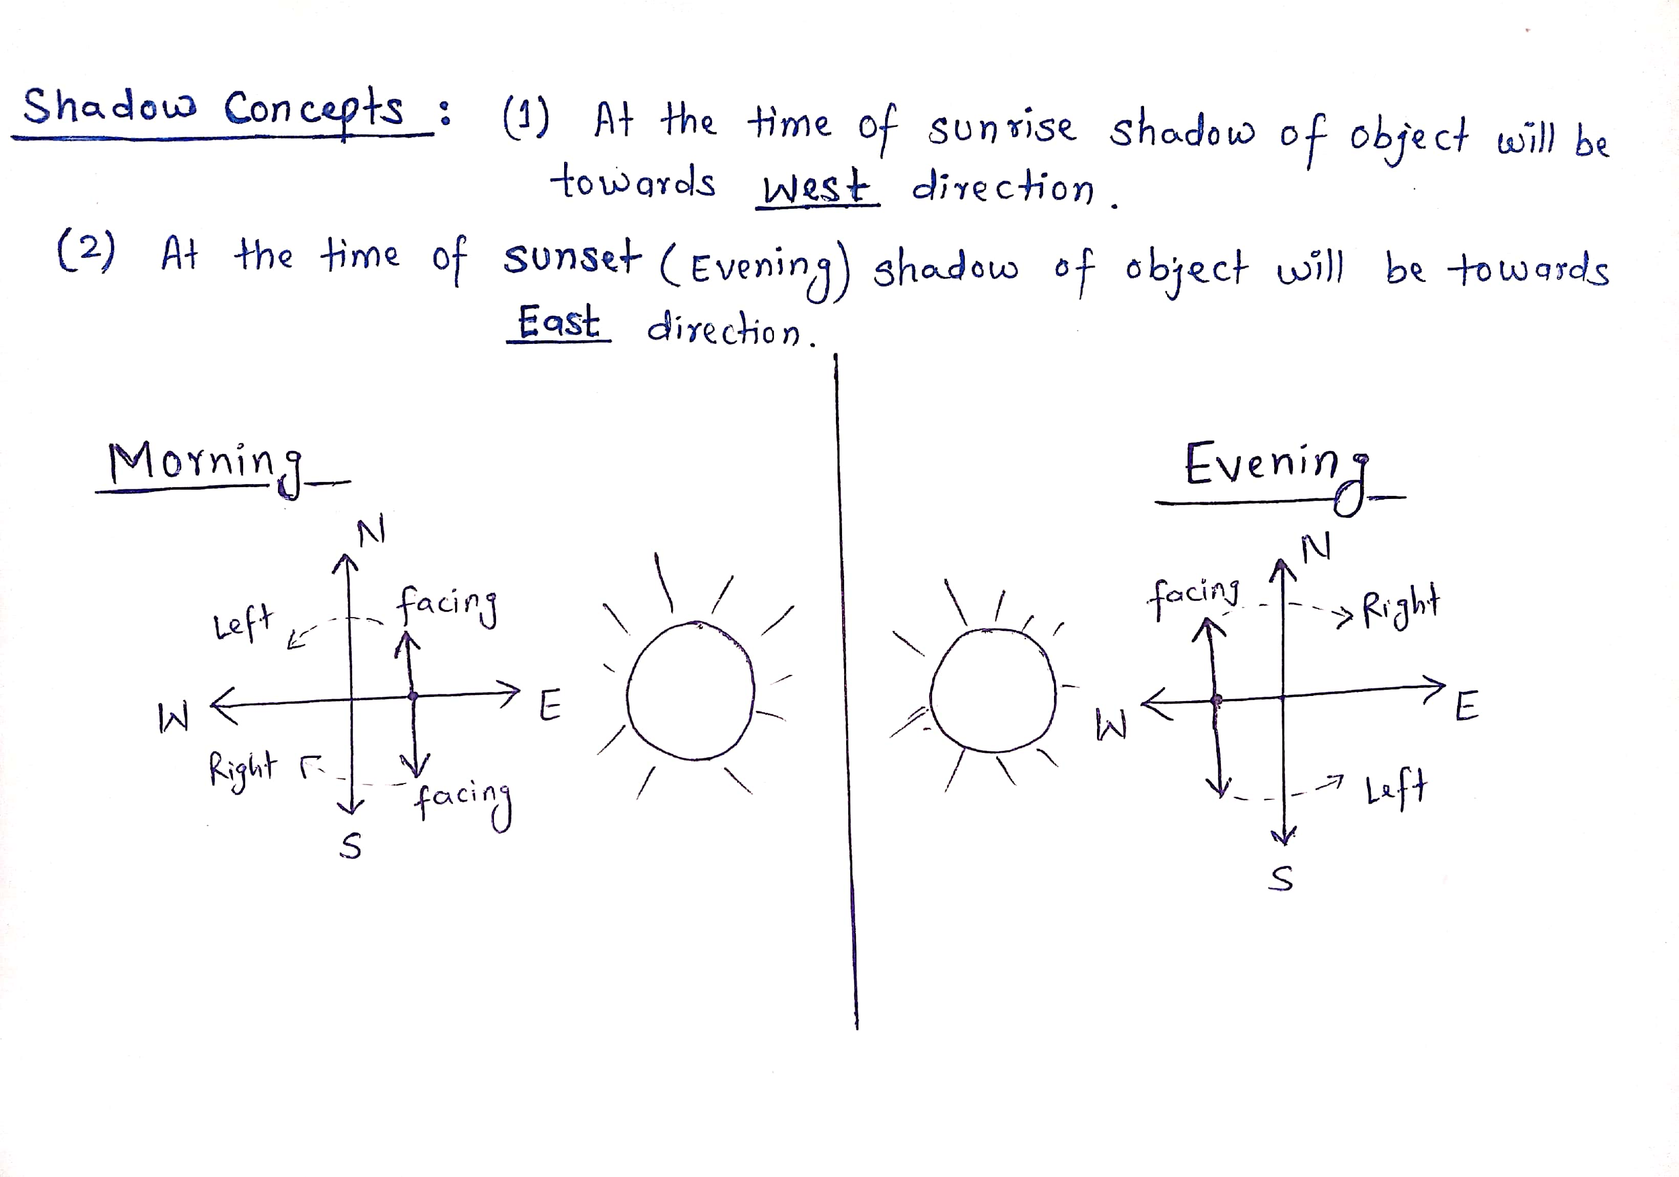

Slide 20
If a man stands facing North in the Morning his shadow will be towards his left and if he is facing North in Evening his shadow will be towards his Right.
If a man stands facing South in the Morning his shadow will be towards his Right and if he is facing South in Evening his Shadow will be towards his Left.

Slide 21
One evening before sunset Rekha and Hema were talking to each other face to face. If Hema’s shadow was exactly to the right of Hema, which direction was Rekha facing?
[A] North
[B] South
[C] East
[D] West

Slide 22
One morning Udai and Vishal were talking to each other face to face at a crossing. If Vishal’s shadow was exactly to the left of Udai, which direction was Udai facing?
[A] East
[B] West
[C] North
[D] South

Slide 23
Roshan walks 10 meters westwards, then turns left and walks 10 meters. He then again turns left and walks 10 meters. He takes a 45 degree turn to his right and walks straight. In which direction is he walking now?
[A] South-East
[B] South
[C] South West
[D] East

Slide 24
After his office hours in the evening, Gautam starts walking facing the sun. First he turns to his right, then he turns to his left and after walking for some meters to his left, he turns to his right. In what direction is he moving now?
[A] South
[B] North
[C] West
[D] East

Slide 25
Amit’s office is situated 5 kilometers North of Ben’s office. Ben starts from his office and walks 2 kilometers towards Amit’s office. He then turns right and walks 3 kilometers and then turns left and walks 3 kilometers. To which direction will he turn to reach Amit’s office?
[A] West
[B] North
[C] South
[D] East

Slide 26
A lady leaves her home and walks 30 meters in North-West direction and then 30 meters in South-West. Next, she walks 30 meters in South-East direction. Finally, she turns towards her house. In which direction is she moving now?
[A] North-East
[B] North-West
[C] South-East
[D] South-West

Slide 27
Deepak walks 8 kilometers East, turns South-West and walks another 8 kilometers. He again takes a turn towards North-West and walks another 8 kilometers. In which direction from his starting point is he standing now?
[A] North-East
[B] South
[C] West
[D] East

Slide 28
The school is to the West of the hospital. The hospital is to the South of the police post. The workshop is to the North of the school. If the 4 places are equidistant from each other, then to which direction of workshop is the police post?
[A] East
[B] West
[C] North
[D] South

Slide 29
Directions for Q21 to Q25:
Joe walks 2 kilometers towards North and turns to his right and walks 4 kilometers more. He then turns to his right and walks 4 kilometers and turns again to his right and walks another 4 kilometers. Here he meets Renu who is coming from the opposite direction. They both stop there.
After taking the first turn, in which direction was Joe going?
[A] South
[B] North
[C] West
[D] East

Slide 30
If the starting point is marked ‘A’ and finishing point is marked ‘B’. What will be the distance between these points?
[A] 10 Km
[B] 8 Km
[C] 6 Km
[D] 2 Km
From which direction was Renu coming?
[A] West
[B] North
[C] East
[D] South-East

Slide 31
After taking the second turn, in which direction was Joe walking?
[A] South
[B] West
[C] North
[D] East
If Joe is to again reach the point from where he started, in which direction will he have to go from where he’s standing now?
[A] East
[B] North
[C] North-East
[D] South-East

Slide 32
A clock is so placed that at 12 noon its minute hand points towards North-East. In which direction does its hour hand point at 1.30 pm?
[A] North
[B] South
[C] East
[D] West
One evening before sunset, two friends Jane and Jackie were talking facing each other. If Jackie's shadow was exactly to his right side, which direction was Jane facing?
[A] North
[B] South
[C] East
[D] West

Slide 33


Slide 34

Blood Relationship

Slide 35
Definition and Concept
Questions in Test of Reasoning on Family/Blood Relationship are about the relationship of a particular person with another person of the family, based on the chain of relationships between other members of that family.
Family/Blood Relation Tests are an exercise to test the student’s ability to comprehend and come to the crux of an issue from complex, lengthy and even confusing data.

Slide 36
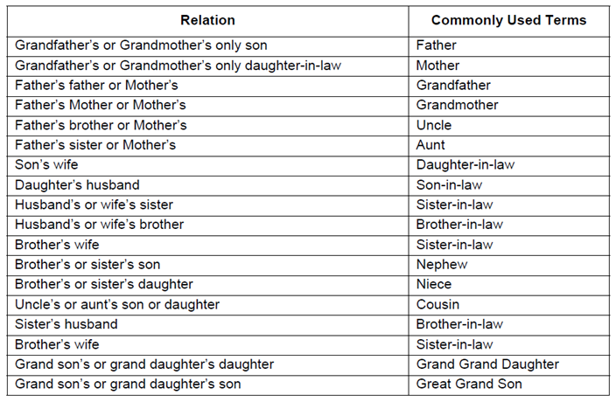

Slide 37
Great-Uncle/Aunt: A brother/sister to any of one's grandparents.
In-laws
In-laws only apply to brother, sister, and parents.
e.g. There is no relationship between you and your spouses cousins. My sister-in-law could be:
1. the sister of my spouse, or
2. the wife of my brother, or
3. the wife of my spouse's brother.

Slide 38
UNCLE: Uncle in American society this term can refer to a man in four different relative positions: father's brother; mother's brother; father's sister's husband; mother's sister's husband.
NEPHEW - NIECE: Nephew or Niece is one who is the child of a sibling (or a half-sibling, or step-sibling, or a child of a spouse's sibling, or your spouse's sibling. Since the term derives from the Latin term, "Nepos" meaning grandson, it is possible an early colonial reference may have this meaning.

Slide 39
Four thumb rule to solve Blood Relation Problems
Male is denoted by + sign and female by - sign in a family tree.
2. Father/mother and Son/daughter are joined by a vertical line to show generation gap between them.
Father/mother
Son/Daughter

Slide 40
3. Siblings(Brother sister) are joined by a horizontal line because there is no generation gap between them.
Brother Sister
Note: We never joined cousins by any line in a family tree as they are siblings from different parents.
4. Married couples are always written adjacent to each other but joined by a couple sign.
Husband Wife

Slide 41
Only use the details provided in the question to form the tree. DO NOT assume values on your own-Unless specifically provided or logically concluded.
Relations on the mother's side is called 'Maternal' while on Father's side is called 'Paternal'.

Slide 42
In every competitive exam and placement exam, Blood relation can be asked in the following three forms:
Type 1 : Indicating type or Deciphering jumbled up description
Type 2 : Relation puzzle ( A set of statements)
Type 3 : Coded blood relation ( In the form of Symbols)

Slide 43
Type 1: Indicating type Problems
1. Introducing Neeta, Anil(Male) said "She is the wife of my mother's only son'". How is Neeta related to Anil?
Wife
Sister
Mother
Aunt

Slide 44
If Kamal says ," Ravi's mother is the only daughter of my mother", how is Kamal related to Ravi ?
Grandfather
Father
Brother
None of these

Slide 45
Pointing towards photograph, Vipul said, "She is the daughter of my grandfather's only son." How is Vipul related to the girl in the photograph ?
Mother
Sister
Cousin
Grand Mother

Slide 46
Pointing towards a person in a photograph, Anjali said, "He is the only son of the father of my sister's brother." How is that person is related to Anjali ?
Father
Cousin
Brother
Maternal Uncle

Slide 47
Pointing out to a lady, Rajan said, “She is the daughter of the woman who is the mother of the husband of my mother”. Who is that lady to Rajan?
Aunt
Grand daughter
Daughter
Sister

Slide 48
If Neha says, "Amrita's father Raj is the only son of my father-in-law Mahesh,” then how Bindu, who is the sister of Amrita related to Mahesh?
Daughter
Wife
Niece
Grand daughter

Slide 49
The son of M is the father of N and grandfather of R. S is the daughter of N and sister of B. How is M related to B?
Grand father
Grand mother
Grand father's father
Data inadequate

Slide 50
Type 2: Relation Puzzle
In these types of problems, relations will be given in the form of puzzle i.e. a set of statements. We need to draw the family tree according to given statements and answer the questions based on those relations.

Slide 51
'Ram' is the father of 'Kusha' but 'Kusha' is not his son. 'Mala' is the daughter of 'Kusha'. 'Shalaka' is the spouse of 'Ram'. 'Gopal' is the brother of 'Kusha'. 'Hari' is the son of 'Gopal'. 'Meena' is the spouse of 'Gopal'. 'Ganpat' is the father of 'Meena'. Who is the grand daughter of 'Ram'?
A. Mala
B. Meena
C. Hari
D. Shalaka

Slide 52
X is the husband of Y. W is the daughter of X. Z is the husband of W. N is the daughter of Z. What is the relationship of N to Y.
A. Cousin
B. Niece
C. Daughter
D. Grand daughter

Slide 53
Directions (3-5):In a family there are eight members. A is mother of B, who is brother of C. C and Q are siblings. Y is daughter of P. Z is brother in law of B, who is son of D. A has only one son. There are only two married couples in the family. P is married to B.
3. How is P related with Z?
A. Brother
B. Daughter
C. Nephew
D. None of these

Slide 54
How is C related with Y?
A. Aunt
B. Daughter in Law
C. Uncle
D. Grand father

Slide 55
How many male members are there in the family?
A. Four
B. Three
C. five
D. Two

Slide 56
Type 3: Coded Blood Relation
In these types of problems, relations will be given in the form of codes and symbols. We need to draw the family tree according to given symbols and answer the questions based on those relations.

Slide 57
‘ P +Q’ means that P is the son of Q, ‘P-Q’ means that P is the wife of Q, ‘P*Q’ means that P is the brother of Q, ‘P/Q’ means that P is the mother of Q and ‘P=Q’ means that P is the sister of Q. then, what does X+Y-Z mean?
Z is the father of X
Z is the son of X
Z is the uncle of X
Z is the brother of X

Slide 58
If ‘A × D’ mean ‘D is the sister of A’, ‘A + D’ means ‘D is the daughter of A’ , ‘A ÷ D’ means ‘A is the wife of D’, and ‘A-D’ means ‘A is brother of D’ then which of the following expression shows ‘J is sister of K’ ?
J - K ÷ P + L
K + P + M × J
J – K ÷ L + P
K – J ÷ L + P

Slide 59
Direction for Q3 & Q4: Study the following information carefully to answer these questions.
‘A$B’ means ‘A is mother of B’
‘A#B’ means ‘A is the father of B’
‘A@B’ means ‘A is the husband of B’
‘A%B’ means ‘A is daughter of B’
P@Q$M#T indicates what relationship of P with T?
Maternal Grandfather
Maternal Grandmother
Paternal Grandfather
None of the above

Slide 60
Which of the following expressions indicates ‘R is the sister of H’?
R$D@F#H
H%D@F$R
R%D@F$H
H$D@F#R

Slide 61
Directions (5-6):
‘A × B’ means ‘A is mother of B’.
‘A – B’ means ‘A is brother of B’.
‘A + B’ means ‘A is sister of B’.
‘A ÷ B’ means ‘A is father of B’.
5. If the expression M × N + R ÷ T is true, then which of the following is true?
A. M is father of R
B. N is aunt of T
C. M is grandfather of T
D. T is sister of N

Slide 62
6. Which of the following means ‘Q’ is brother of ‘T’?
A. Y ÷ Q – T + R
B. T ÷ Q – Y- R
C. T × M – R + Q
D. T + M ÷ Y + Q

